Slide 1

Apex Institute of Technology
Department of Computer Science & Engineering
Data Mining and Warehousing
(CSF-334)
Dr Neha Agarwal
E11231
Assistant Professor
CSE(AIT), CU
DISCOVER . LEARN . EMPOWER

Slide 2
Contents to be Covered
Mining descriptive statistical measures in large databases

Slide 3
Mining Data Dispersion Characteristics
Motivation
To better understand the data: central tendency, variation and spread
Data dispersion characteristics
median, max, min, quantiles, outliers, variance, etc.
Numerical dimensions correspond to sorted intervals
Data dispersion: analyzed with multiple granularities of precision
Boxplot or quantile analysis on sorted intervals
Dispersion analysis on computed measures
Folding measures into numerical dimensions
Boxplot or quantile analysis on the transformed cube

Slide 4
Measuring the Central Tendency
Mean
Weighted arithmetic mean
Median: A holistic measure
Middle value if odd number of values, or average of the middle two values otherwise
estimated by interpolation
Mode
Value that occurs most frequently in the data
Unimodal, bimodal, trimodal
Empirical formula:

Slide 5
Measuring the Dispersion of Data
Quartiles, outliers and boxplots
Quartiles: Q₁ (25th percentile), Q₃ (75th percentile)
Inter-quartile range: IQR = Q₃ – Q₁
Five number summary: min, Q₁, M, Q₃, max
Boxplot: ends of the box are the quartiles, median is marked, whiskers, and plot outlier individually
Outlier: usually, a value higher/lower than 1.5 x IQR
Variance and standard deviation
Variance s²: (algebraic, scalable computation)
Standard deviation s is the square root of variance s²

Slide 6
Boxplot Analysis
Five-number summary of a distribution:
Minimum, Q1, M, Q3, Maximum
Boxplot
Data is represented with a box
The ends of the box are at the first and third quartiles, i.e., the height of the box is IRQ
The median is marked by a line within the box
Whiskers: two lines outside the box extend to Minimum and Maximum

Slide 7
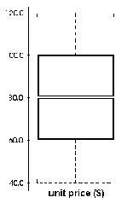
A Boxplot
A boxplot

Slide 8
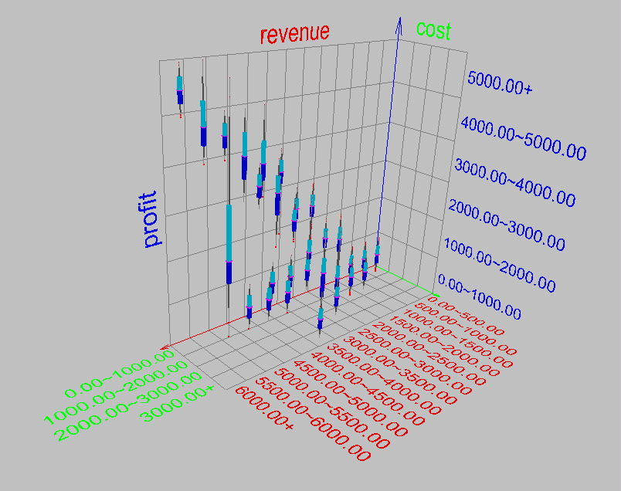
Visualization of Data Dispersion: Boxplot Analysis

Slide 9
Mining Descriptive Statistical Measures in Large Databases
Variance
Standard deviation: the square root of the variance
Measures spread about the mean
It is zero if and only if all the values are equal
Both the deviation and the variance are algebraic

Slide 10
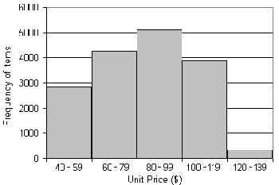
Histogram Analysis
Graph displays of basic statistical class descriptions
Frequency histograms
A univariate graphical method
Consists of a set of rectangles that reflect the counts or frequencies of the classes present in the given data

Slide 11
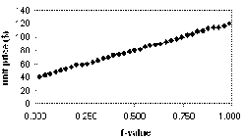
Quantile Plot
Displays all of the data (allowing the user to assess both the overall behavior and unusual occurrences)
Plots quantile information
For a data x_{i} data sorted in increasing order, f_{i} indicates that approximately 100 f_{i}% of the data are below or equal to the value x_{i}

Slide 12
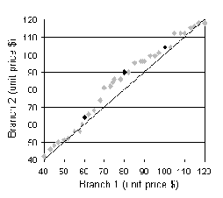
Quantile-Quantile (Q-Q) Plot
Graphs the quantiles of one univariate distribution against the corresponding quantiles of another
Allows the user to view whether there is a shift in going from one distribution to another

Slide 13
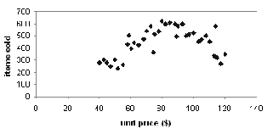
Scatter plot
Provides a first look at bivariate data to see clusters of points, outliers, etc
Each pair of values is treated as a pair of coordinates and plotted as points in the plane

Slide 14
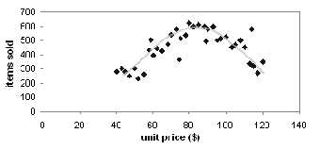
Loess Curve
Adds a smooth curve to a scatter plot in order to provide better perception of the pattern of dependence
Loess curve is fitted by setting two parameters: a smoothing parameter, and the degree of the polynomials that are fitted by the regression

Slide 15
Graphic Displays of Basic Statistical Descriptions
Histogram: (shown before)
Boxplot: (covered before)
Quantile plot: each value x_{i} is paired with f_{i} indicating that approximately 100 f_{i} % of data are ≤ x_{i}
Quantile-quantile (q-q) plot: graphs the quantiles of one univariant distribution against the corresponding quantiles of another
Scatter plot: each pair of values is a pair of coordinates and plotted as points in the plane
Loess (local regression) curve: add a smooth curve to a scatter plot to provide better perception of the pattern of dependence

Slide 16
Homework
Explain Mining Descriptive Statistical Measures in Large Databases.
Discuss difference between box plot and scatter plot?

Slide 17
References
TEXT BOOKS
Introduction to Data Mining, Tan, Steinbach and Vipin Kumar, Pearson Education, 2016
REFERENCE BOOKS
Data Mining: Concepts and Techniques, Pei, Han and Kamber, Elsevier (2nd edition)
Journals
https://www.sciencedirect.com/topics/computer-science/data-generalization

Slide 18
Thank you
Please Send Your Queries on:
e-Mail: neha.e11231@cumail.in

